Slide 1
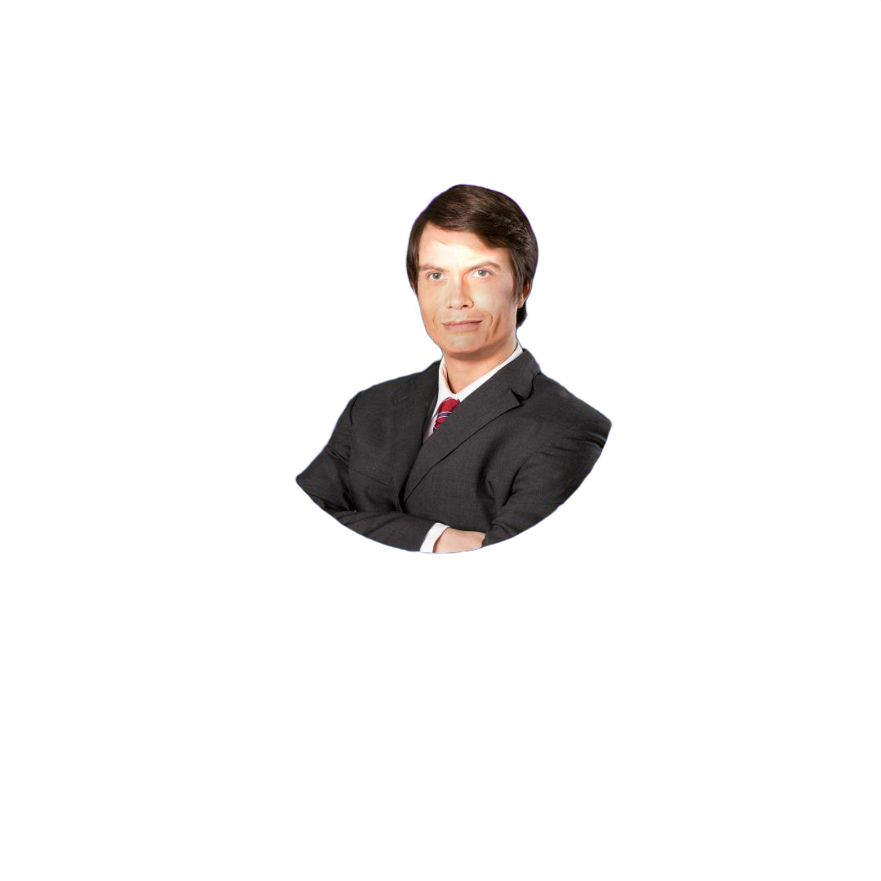
VOTE JAMES SMITH
FOR A
BROKEN & BITTER
FUTURE.
Election date | Feb 2024

Slide 2


Party E

Slide 3
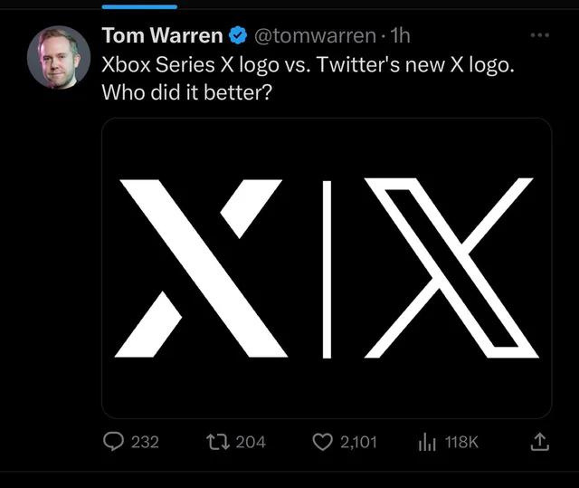

Party E
@partyE
Let’s do this together. We need your help to make build a green future.

Slide 4
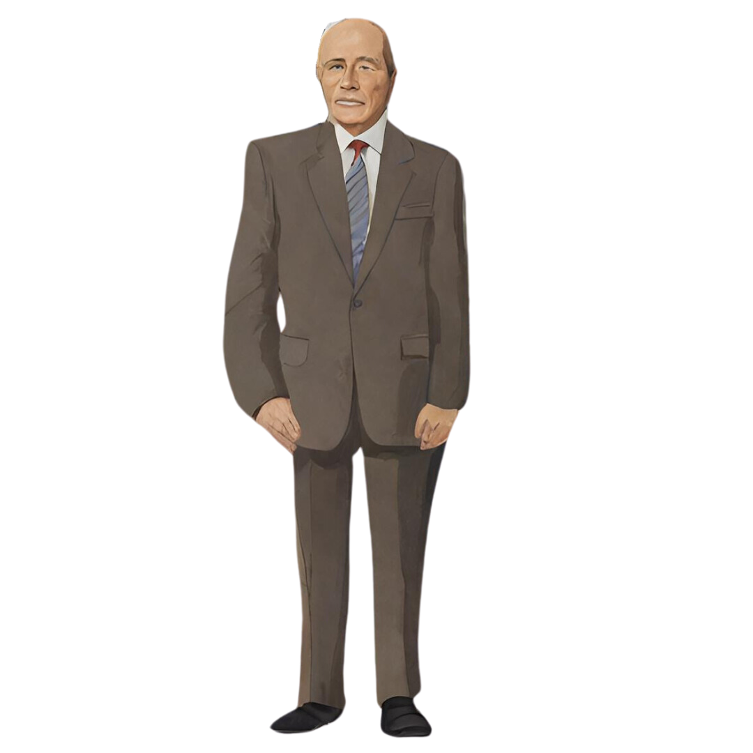

Slide 5
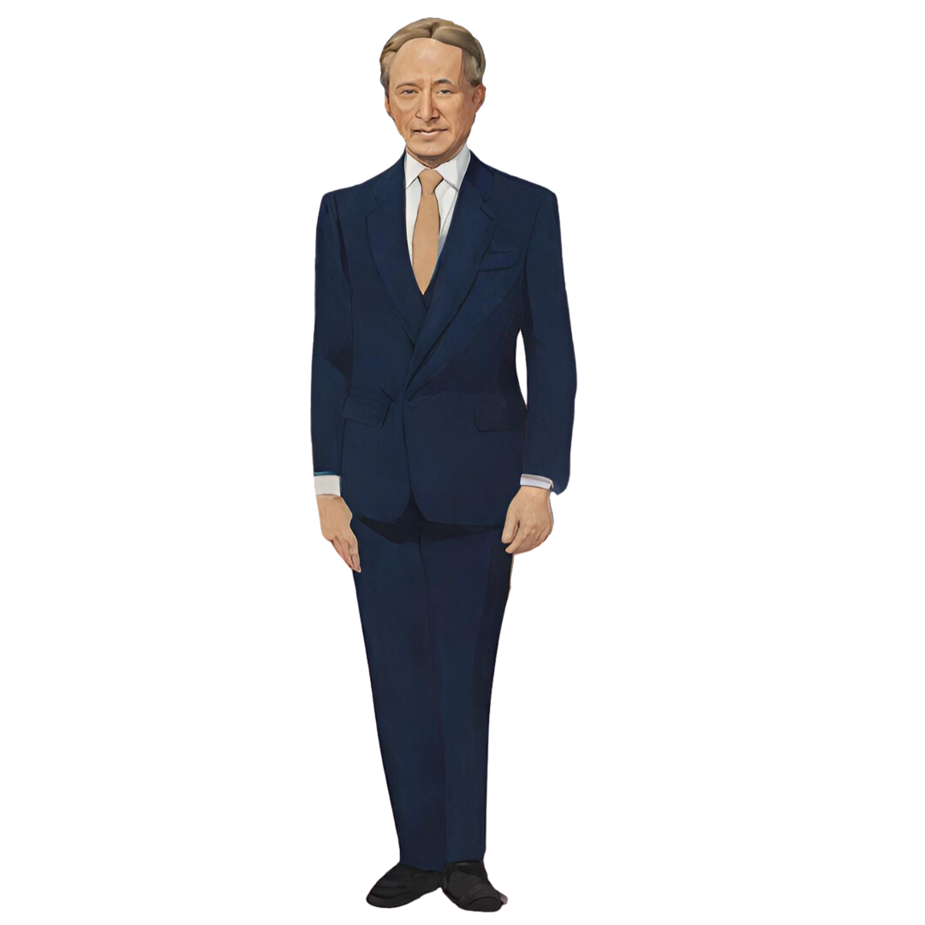

Slide 6
INVESTIGATION
members of the 'Party J' accused of attempting to hack into the internet to change social media algorithms.
BREAKING NEWS
allegations on 'Party J' for hiring a private intelligence firm to gather personal data on rival candidates.
BEWARE! allegations of tax evasion and fraud against this candidate.
Currently under investigation for misuse of public funds for
personal gain.

